Slide 1
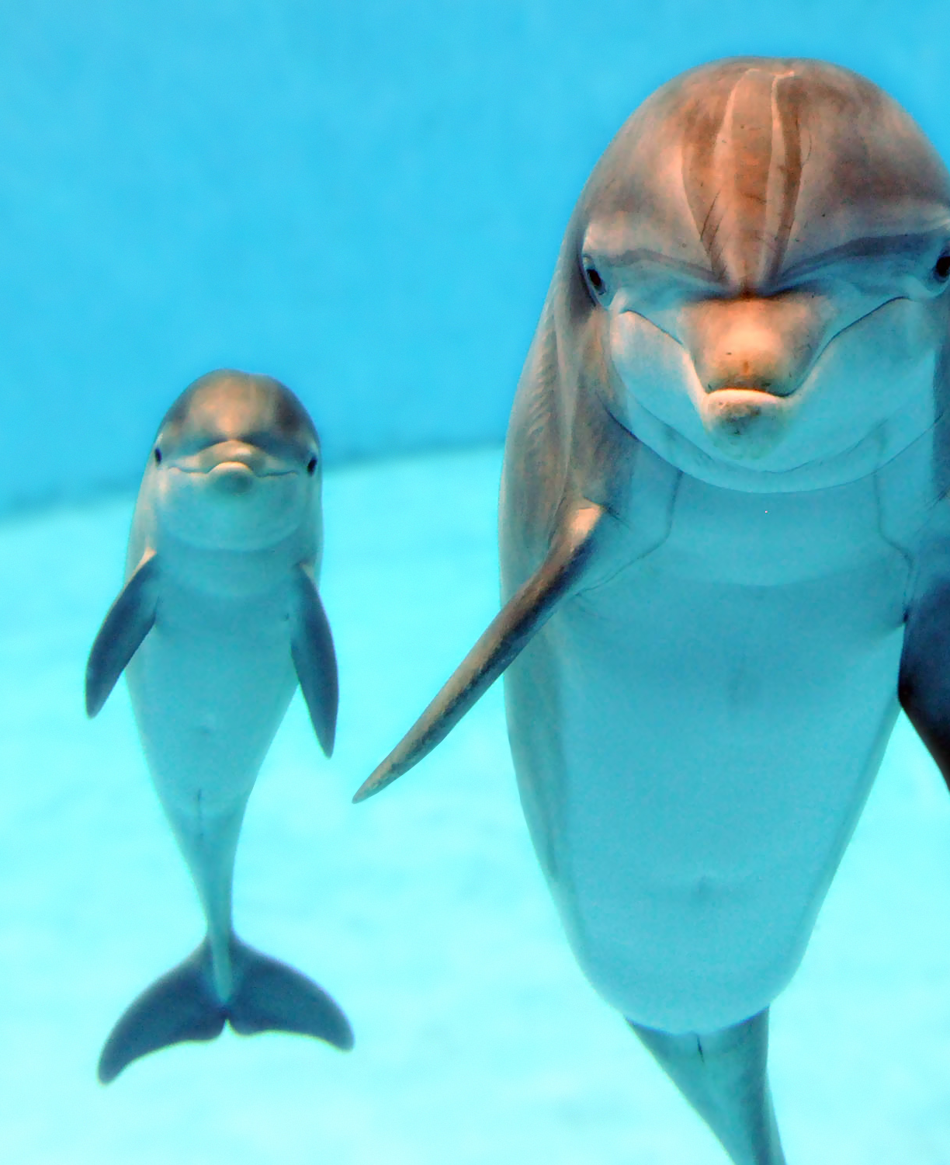
Personality
Chapter 11

Slide 2
Agenda
What is Personality?
Perspectives & Approaches
Personality Assessment

Slide 3

What IS personality?

Slide 4
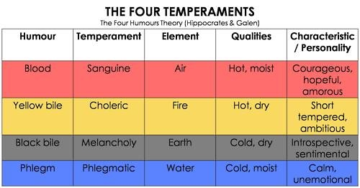
Historical Perspectives- The Humors

Slide 5
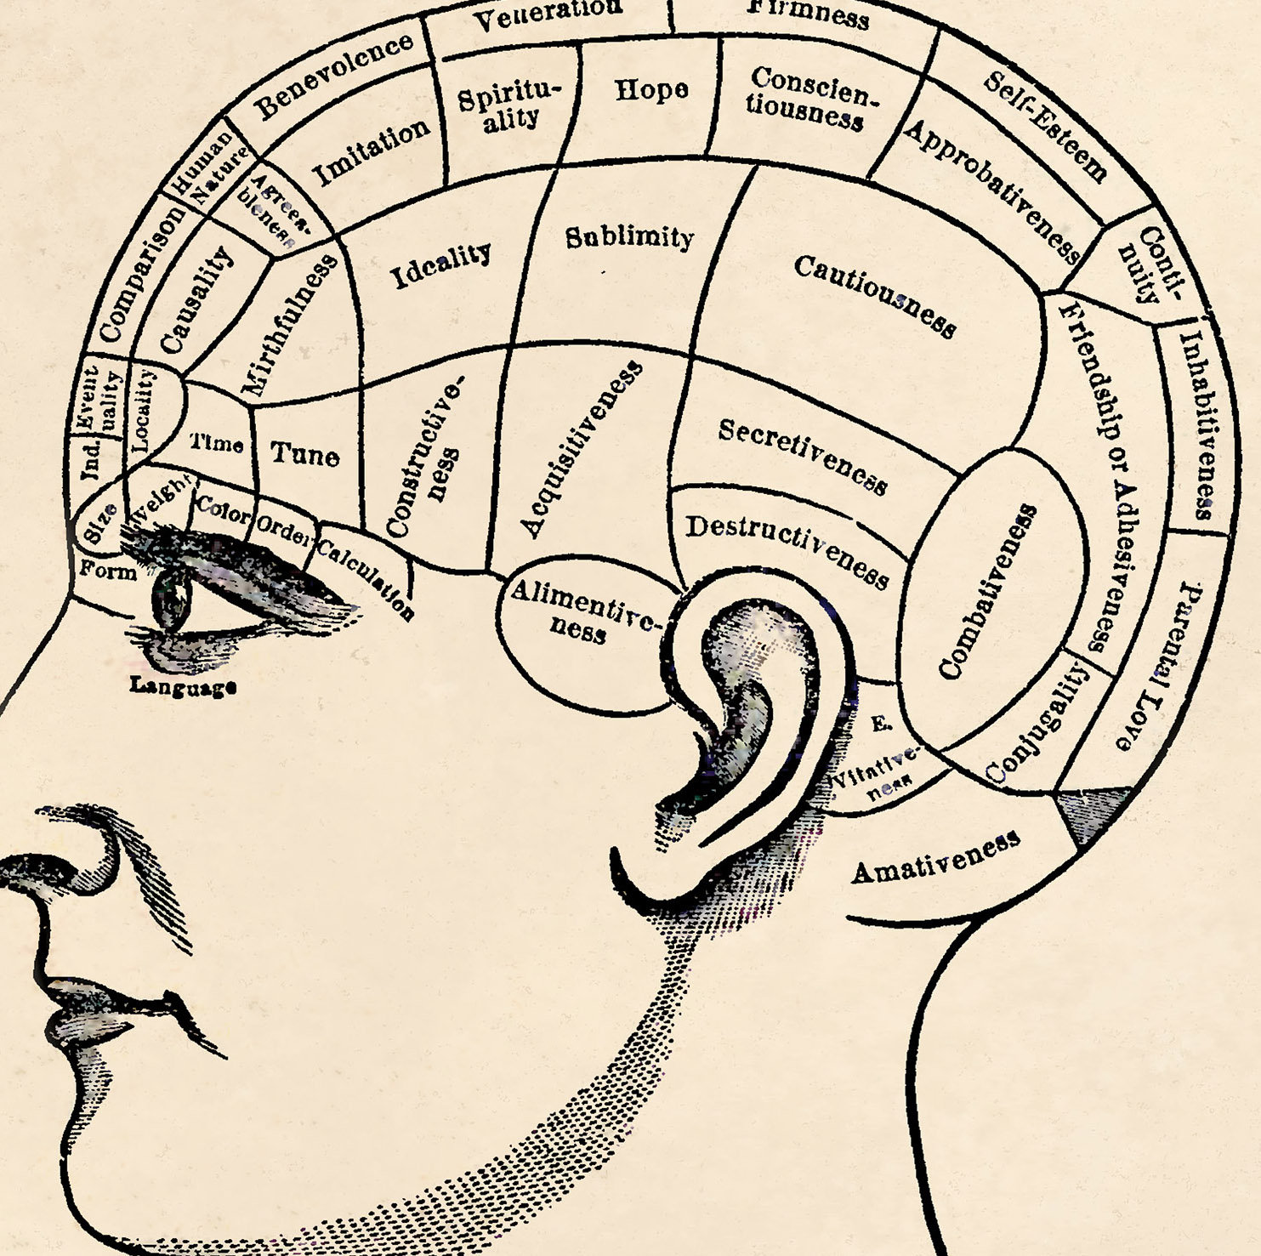
Historical Perspectives- Phrenology Franz Gall

Slide 6
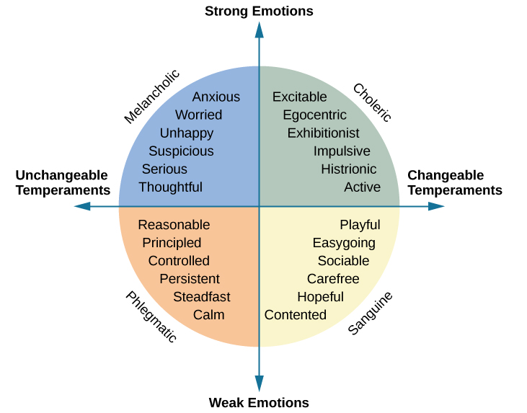
Historical Perspectives- The Humors 2.0 Wilhelm Wundt

Slide 7
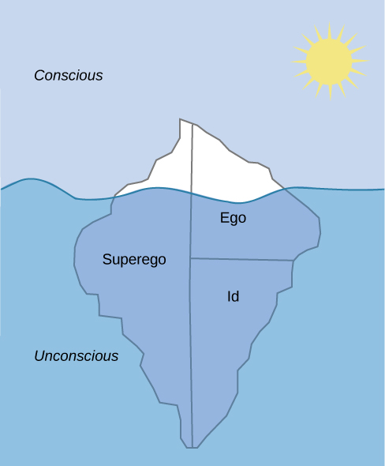
Freud’s Levels of Consciousness

Slide 8
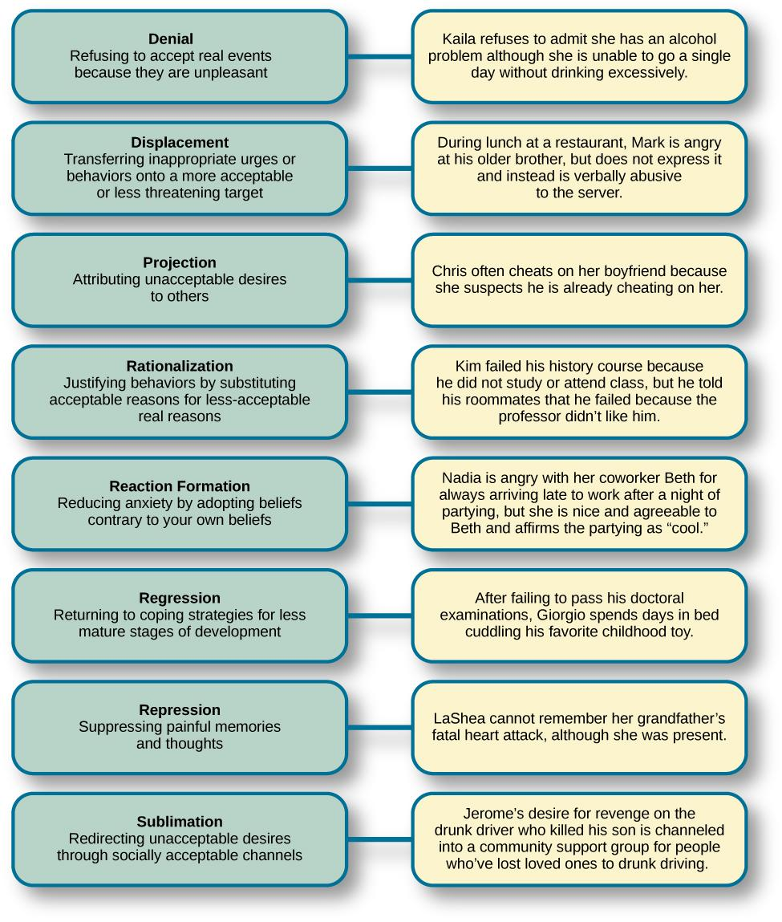
Freud’s Defense Mechanisms

Slide 9
Freud’s Stages of Psychosexual Development
Stage | Age (years) | Erogenous Zone | Major Conflict | Adult Fixation Example
Oral | 0–1 | Mouth | Weaning off breast or bottle | Smoking, overeating
Anal | 1–3 | Anus | Toilet training | Neatness, messiness
Phallic | 3–6 | Genitals | Oedipus/Electra complex | Vanity, overambition
Latency | 6–12 | None | None | None
Genital | 12+ | Genitals | None | None

Slide 10
Neo-Freudians

Slide 11
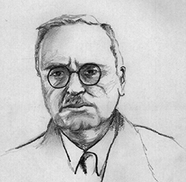
Alfred Adler: Individual Psychology
Inferiority complex
Social connection
The three fundamental social tasks
Birth order

Slide 12
Erik Erikson: Psychosocial Stages
Stage | Age (years) | Developmental Task | Description
1 | 0–1 | Trust vs. mistrust | Trust (or mistrust) that basic needs, such as nourishment and affection, will be met
2 | 1–3 | Autonomy vs. shame/doubt | Sense of independence in many tasks develops
3 | 3–6 | Initiative vs. guilt | Take initiative on some activities, may develop guilt when success not met or boundaries overstepped
4 | 7–11 | Industry vs. inferiority | Develop self-confidence in abilities when competent or sense of inferiority when not
5 | 12–18 | Identity vs. confusion | Experiment with and develop identity and roles
6 | 19–29 | Intimacy vs. isolation | Establish intimacy and relationships with others
7 | 30–64 | Generativity vs. stagnation | Contribute to society and be part of a family
8 | 65– | Integrity vs. despair | Assess and make sense of life and meaning of contributions

Slide 13
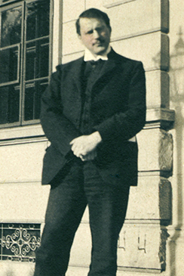
Carl Jung: Analytical Psychology
Balance between conscious and unconscious thought
Collective unconscious
Archetypes
Extroversion vs Introversion

Slide 14
Karen Horney and Unconscious Anxiety
Coping Style | Description | Example
Moving toward people | Affiliation and dependence | Child seeking positive attention and affection from parent; adult needing love
Moving against people | Aggression and manipulation | Child fighting or bullying other children; adult who is abrasive and verbally hurtful, or who exploits others
Moving away from people | Detachment and isolation | Child withdrawn from the world and isolated; adult loner

Slide 15
Learning Approaches
Behaviorist Perspective
Social Cognitive Perspective

Slide 16
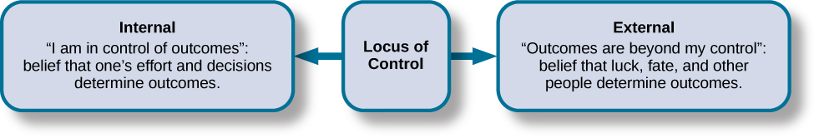
The Locus of Control Julian Rotter

Slide 17
Humanistic Approaches
Abraham Maslow
Hierarchy of Needs
Carl Rogers
Ideal Self vs Real Self

Slide 18
How might a study with twins provide information about the biological approach to personality?

Slide 19
Trait Theories

Slide 20
Cattell’s 16 personality factors
Factor | Low Score | High Score
Warmth | Reserved, detached | Outgoing, supportive
Intellect | Concrete thinker | Analytical
Emotional stability | Moody, irritable | Stable, calm
Aggressiveness | Docile, submissive | Controlling, dominant
Liveliness | Somber, prudent | Adventurous, spontaneous
Dutifulness | Unreliable | Conscientious
Social assertiveness | Shy, restrained | Uninhibited, bold
Sensitivity | Tough-minded | Sensitive, caring
Paranoia | Trusting | Suspicious
Abstractness | Conventional | Imaginative
Introversion | Open, straightforward | Private, shrewd
Anxiety | Confident | Apprehensive
Openmindedness | Closeminded, traditional | Curious, experimental
Independence | Outgoing, social | Self-sufficient
Perfectionism | Disorganized, casual | Organized, precise
Tension | Relaxed | Stressed

Slide 21
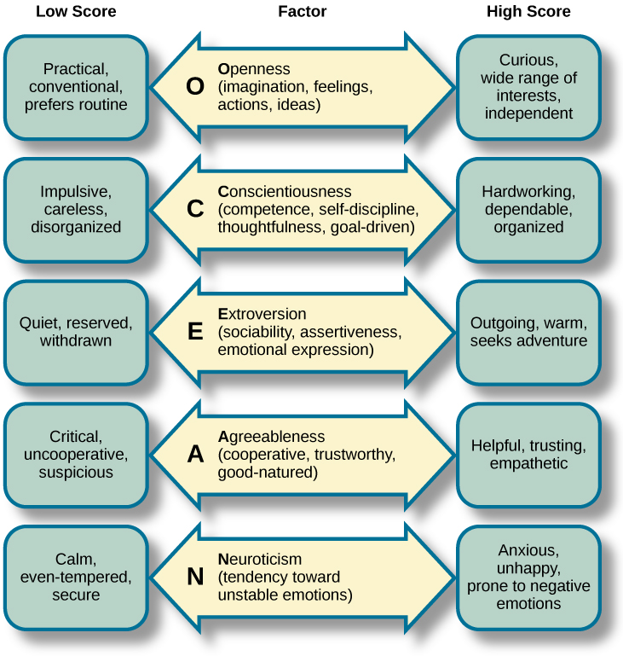
The Five Factor Model

Slide 22
The Hexaco Traits
Trait | Example Aspects of Trait
(H) Honesty-humility | Sincerity, modesty, faithfulness
(E) Emotionality | Sentimentality, anxiety, sensitivity
(X) Extraversion | Sociability, talkativeness, boldness
(A) Agreeableness | Patience, tolerance, gentleness
(C) Conscientiousness | Organization, thoroughness, precision
(O) Openness | Creativity, inquisitiveness, innovativeness

Slide 23
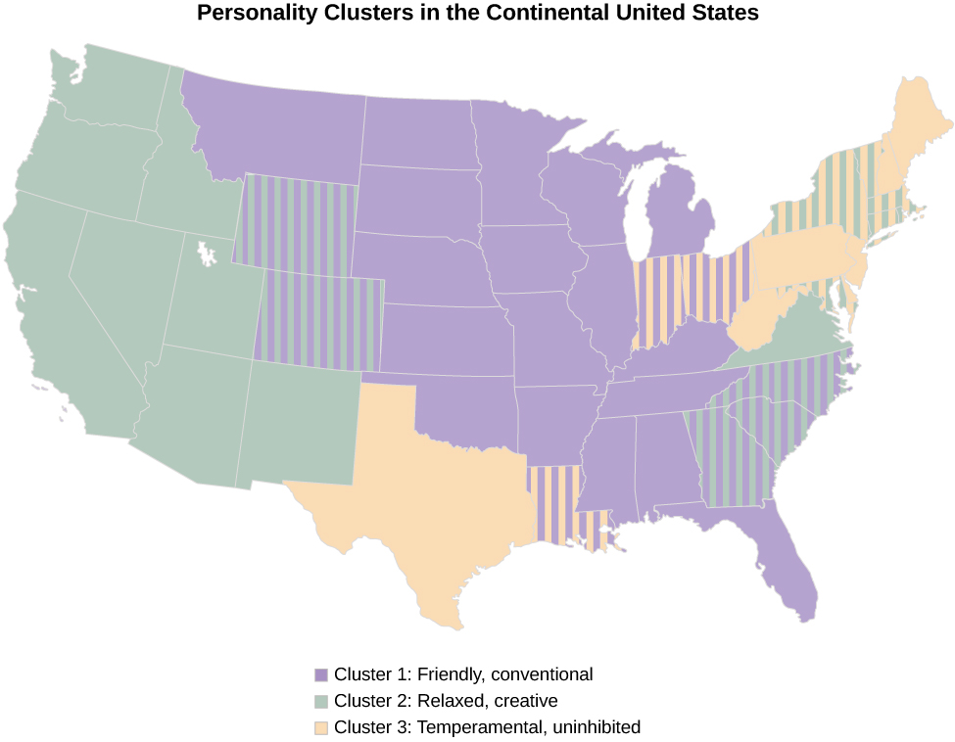
Culture’s Influence on Personality

Slide 24

What purpose could a personality test serve?

Slide 25
Personality Assessments
Self-report vs projective testing
The Rorschach Inkblot Test
The Thematic Appreciation Test (TAT)
The Rotter Incomplete Sentence Blank (RISB)
The Minnesota Multiphasic Personality Inventory (MMPI)

Slide 26
Next time on PSY 203…
BEFORE NEXT CLASS:
Read Chapter 12
Chapter 12 Quiz
NEXT CLASS:
Chapter 12- Social Psychology

